Slide 1
RaBitQ: Practical and Asymptotically Optimal Quantization of High-Dimensional Vectors
Presenter: Jianyang Gao
Nanyang Technological University
Dec/2025 @ FOCS

Slide 2
Outline
Background
The RaBitQ Algorithm
Empirical Studies
Discussion

Slide 3

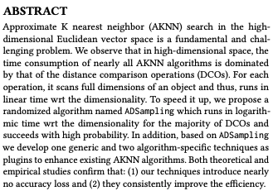
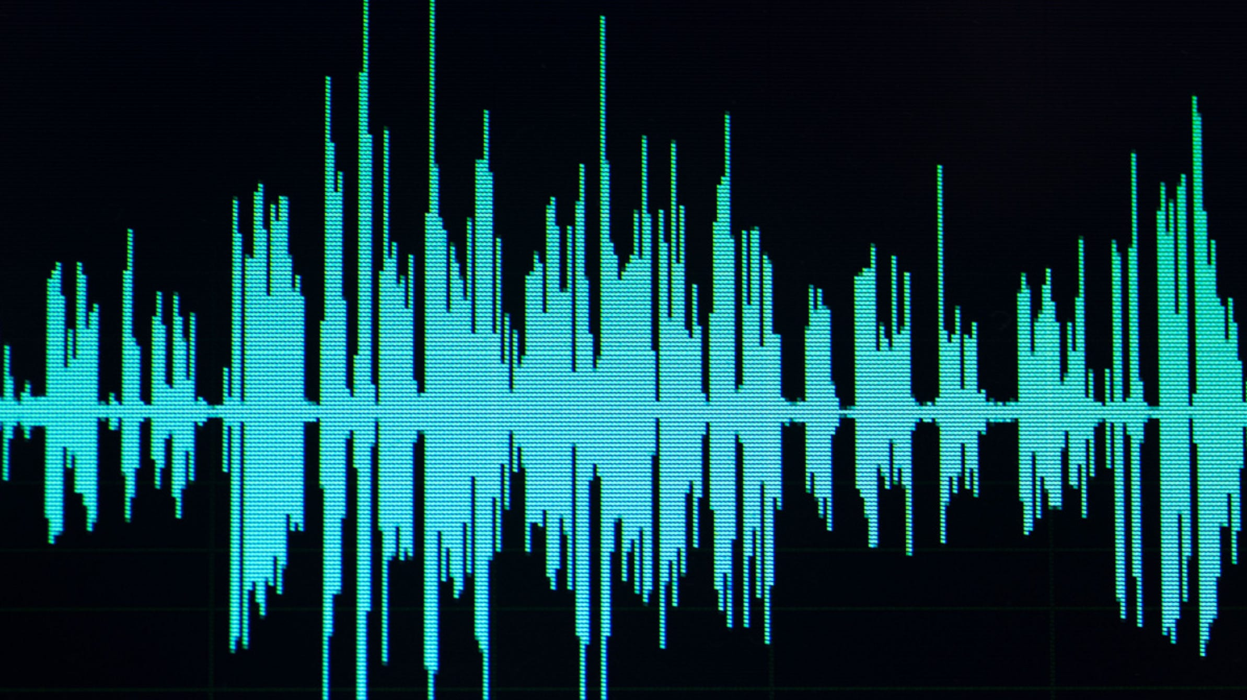
High-Dimensional Vector Data
Deep learning models map unstructured data to high-dimensional vectors.
  data points with similar semantics -> vectors with small Euclidean distances.
Image
Model
Text
Audio
High-Dimensional Vector
(dim. > 100)
Unstructured Data

Slide 4

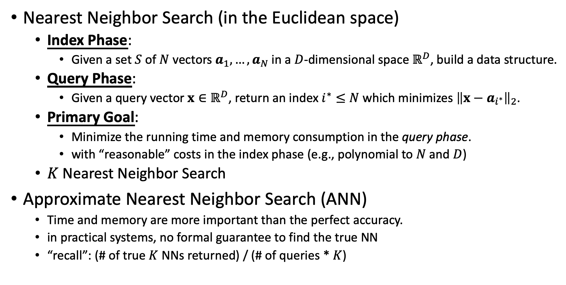
Nearest Neighbor Search
Nearest Neighbor Search (in the Euclidean space)
  Index Phase:
    Given a set $S$ of $N$ vectors $a_{1},…,a_{N}$ in a $D$-dimensional space $ℝ^{D}$, build a data structure.
  Query Phase:
    Given a query vector $x∈ℝ^{D}$, return an index $i^{∗}≤N$ which minimizes ${\left\|x−a_{i^{∗}}\right\|}_{2}$.
  Primary Goal:
    Minimize the running time and memory consumption in the query phase.
    with “reasonable” costs in the index phase (e.g., polynomial to $N$ and $D$)
  $K$ Nearest Neighbor Search
Approximate Nearest Neighbor Search (ANN)
  Time and memory are more important than the perfect accuracy.
  in practical systems, no formal guarantee to find the true NN
  “recall”: (# of true $K$ NNs returned) / (# of queries * $K$)
$$D=Ω(\log{ N})$$

Slide 5

Nearest Neighbor Search
Hardness of Exact and Approximate NN
  [Borodin–Ostrovsky–Rabani, ’99] [Rubinstein, ‘18]
ANN Index in Practice
  Partition-based
    IVF [Jégou et al., ‘11], SPANN [Chen et al., ‘21]
  Graph-based
    HNSW [Malkov-Yashunin ‘18], DiskANN [Subramanya et al., ‘19] [Indyk-Xu, ‘23]
Index
Candidate $S′⊂S$
$$|S′|≪|S|$$
Query Vector
ANN

Slide 6

Nearest Neighbor Search
Index
Candidate$S′⊂S$
$$|S′|≪|S|$$
Query Vector
ANN
Storing and computing distances for high-dim vectors are expensive.
  High Dimensionality: OpenAI generates vectors with >3,000 dimensions.
Distance Sketch: Dimension Reduction & Quantization

Slide 7
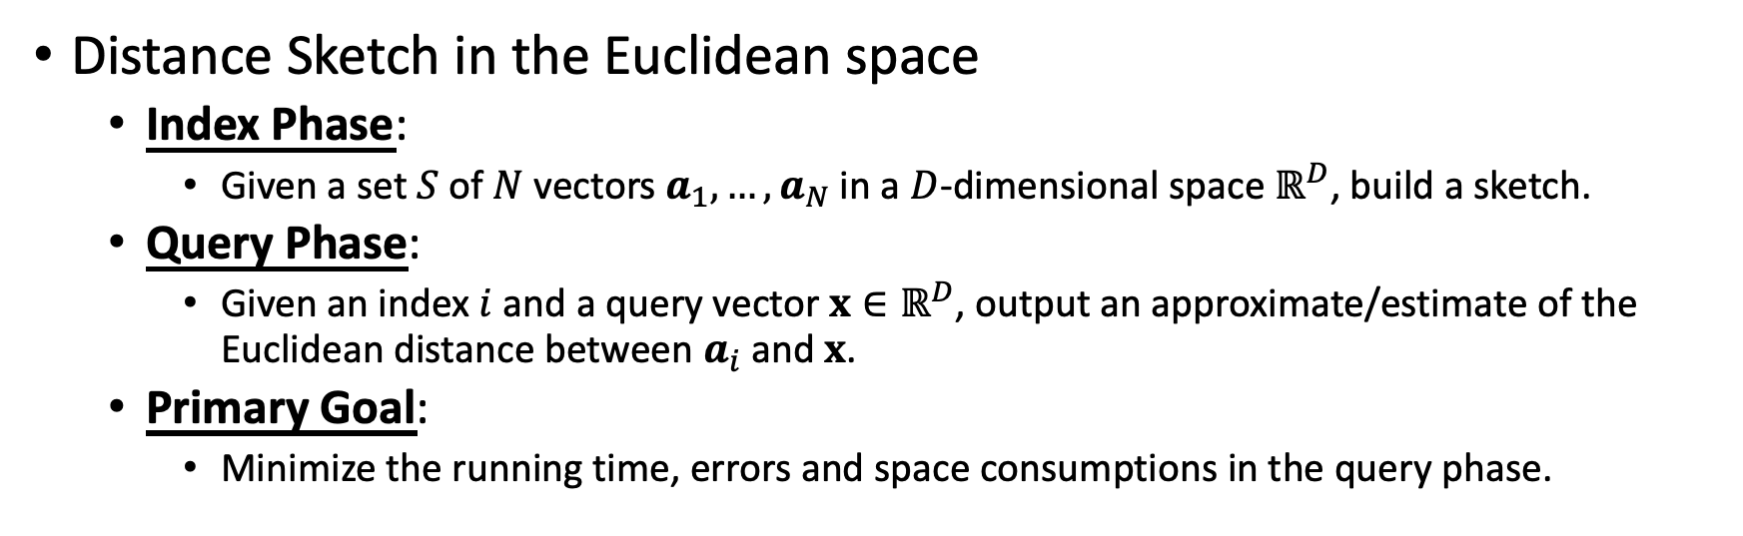
Distance Sketch
Distance Sketch in the Euclidean space
  Index Phase:
    Given a set $S$ of $N$ vectors $a_{1},…,a_{N}$ in a $D$-dimensional space $ℝ^{D}$, build a sketch.
  Query Phase:
    Given an index $i$ and a query vector $x∈ℝ^{D}$, output an approximate/estimate of the Euclidean distance between $a_{i}$and $x$.
  Primary Goal:
    Minimize the running time, errors and space consumptions in the query phase.

Slide 8
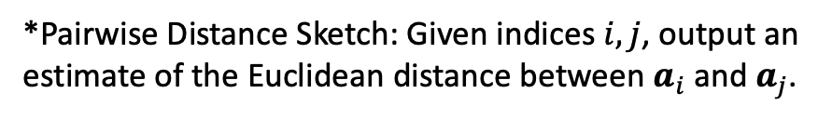
Distance Sketch
Distance Sketch in Practice
  Dimension Reduction
    PCA [Pearson, ‘01], Random Projection [Johnson-Lindenstrauss, ‘84]
  Quantization
    PQ [Jégou et al., ‘11], OPQ [Ge et al., ‘13], LVQ [Aguerrebere et al., ’23], Qinco [Huijben et al., ‘24]
Distance Sketch in Theory
  Optimal Dimension Reduction [Larsen-Nelson, ‘16]
  Optimal Distance Sketch with Additive Error Bounds [Alon-Klartag ‘17]
  Optimal Pairwise Distance Sketch with Multiplicative Error Bounds [Indyk-Wagner ‘17] [Indyk-Wagner ‘22]
*Pairwise Distance Sketch: Given indices $i,j$, output an estimate of the Euclidean distance between $a_{i}$and $a_{j}$.

Slide 9
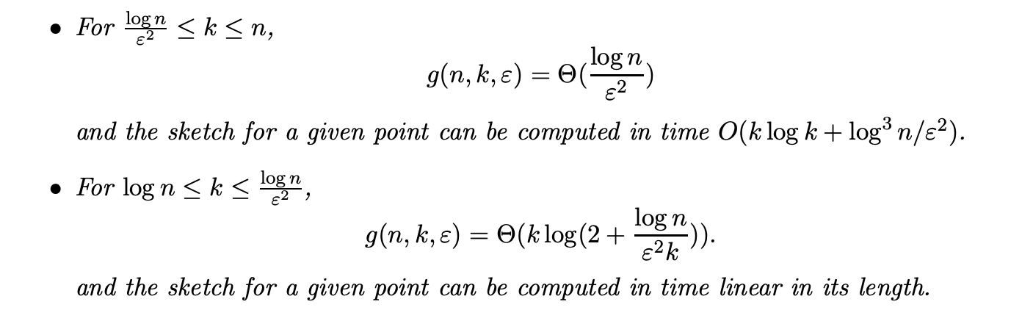
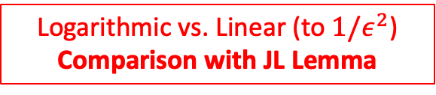
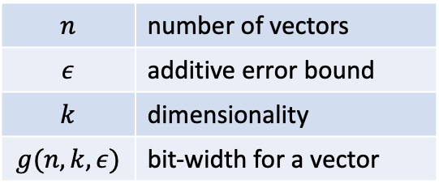
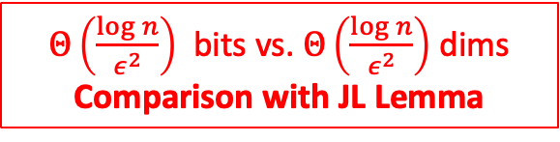
Optimality [Alon-Klartag ‘17]
$$n$$ | number of vectors
$$ε$$ | additive error bound
$$k$$ | dimensionality
$$g(n,k,ε)$$ | bit-width for a vector
$Θ\left(\frac{\log{n}}{ε^{2}}\right)$ bits vs. $Θ\left(\frac{\log{n}}{ε^{2}}\right)$ dims
Comparison with JL Lemma
high dim. & low acc.
JL Lemma
high dim. & high acc.
Logarithmic vs. Linear (to $1/ε^{2}$)
Comparison with JL Lemma

Slide 10
Limitation [Alon-Klartag ‘17]
Algorithmic Proof:
  represent different coordinates with different bit-widths
Implication in Practice:
  unaligned storage
  extra time of decoding for distance computation
*Padding will increase the space complexity and break the optimality.

Slide 11
Outline
Background
The RaBitQ Algorithm
Empirical Studies
Discussion

Slide 12
Goal
Goal: a practical algorithm which achieves the optimality by [Alon-Klartag ’17]
  Focus: to output inner product between unit vectors up to an additive error bound
“Practical”
  sketch/code
    a sequence of unsigned integers with the same bit-width
  distance computation
    native arithmetic operations of unsigned integers without decoding
  more features…

Slide 13
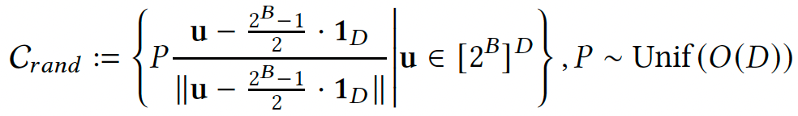

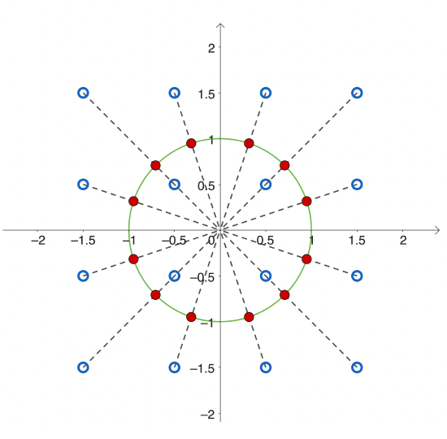
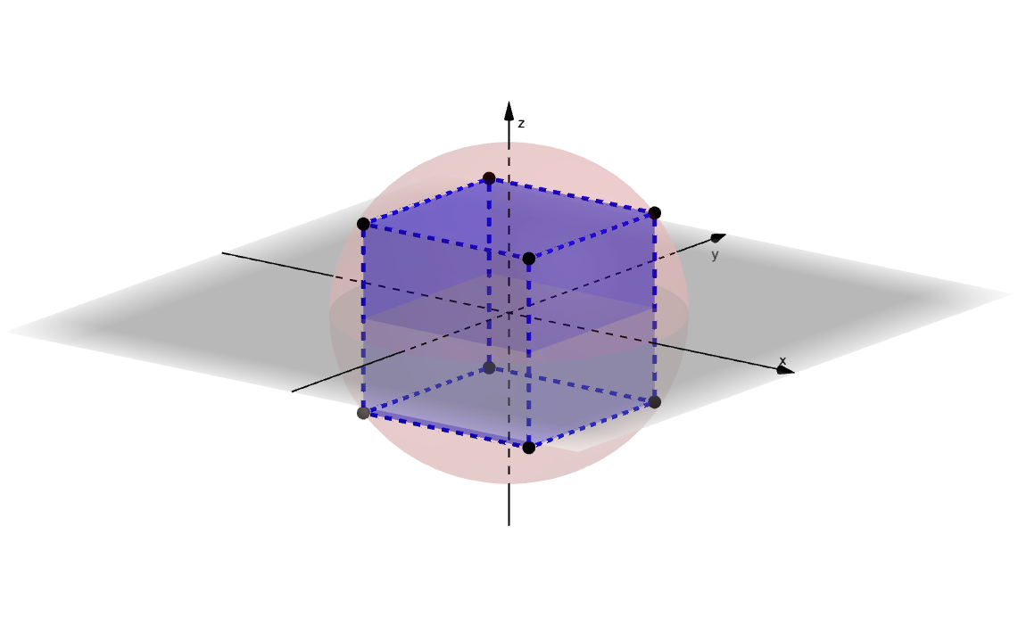
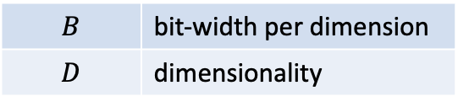
Index Phase
$$B$$ | bit-width per dimension
$$D$$ | dimensionality
Step 1: Construct a (randomized) net/codebook
1-bit codebook (3-dim)
2-bit codebook (2-dim)
Step 2: For a data vector $a$, find $\hat{a}∈𝒞_{rand}$ such that $\left\langle a,\hat{a}\right\rangle$ is maximized.
(1).It samples the random matrix $P$. (2).It stores the corresponding $u$ of $\hat{a}$.

Slide 14
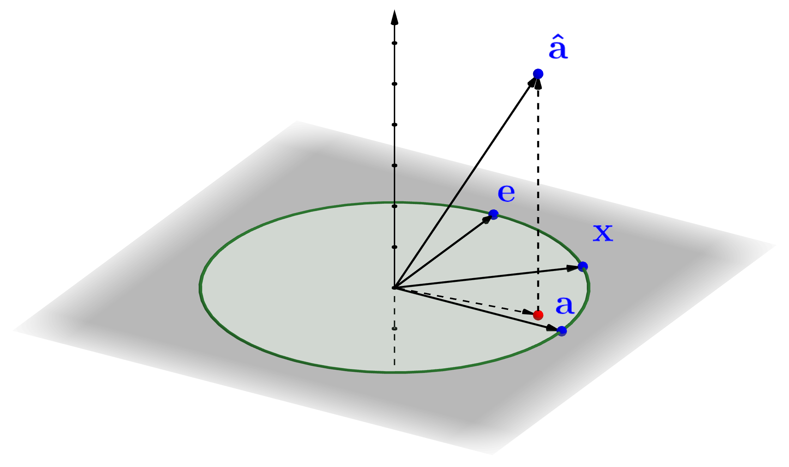
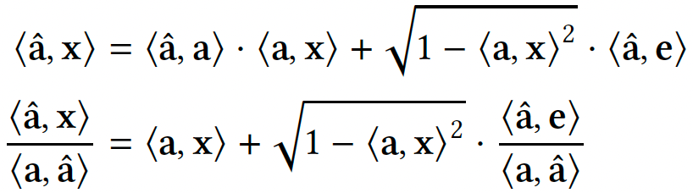
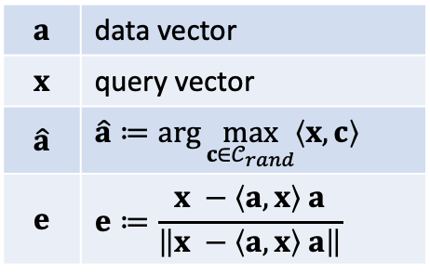
Query Phase
$$a$$ | data vector
$$x$$ | query vector
$$\hat{a}$$ | $$\hat{a}≔arg{\max_{c∈𝒞_{rand}}\left\langle x,c\right\rangle }$$
$$e$$ | $$e≔\frac{x −\left\langle a,x\right\rangle a}{\left\|x −\left\langle a,x\right\rangle a\right\|}$$
How to estimate $\left\langle a,x\right\rangle$ based on $\hat{a}$?
Estimator
Target
Error

Slide 15
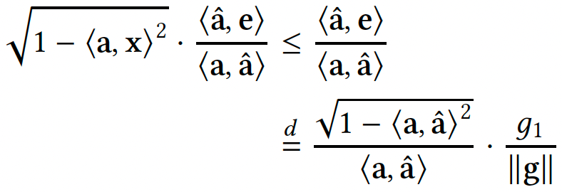


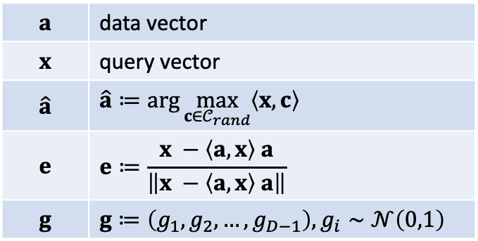
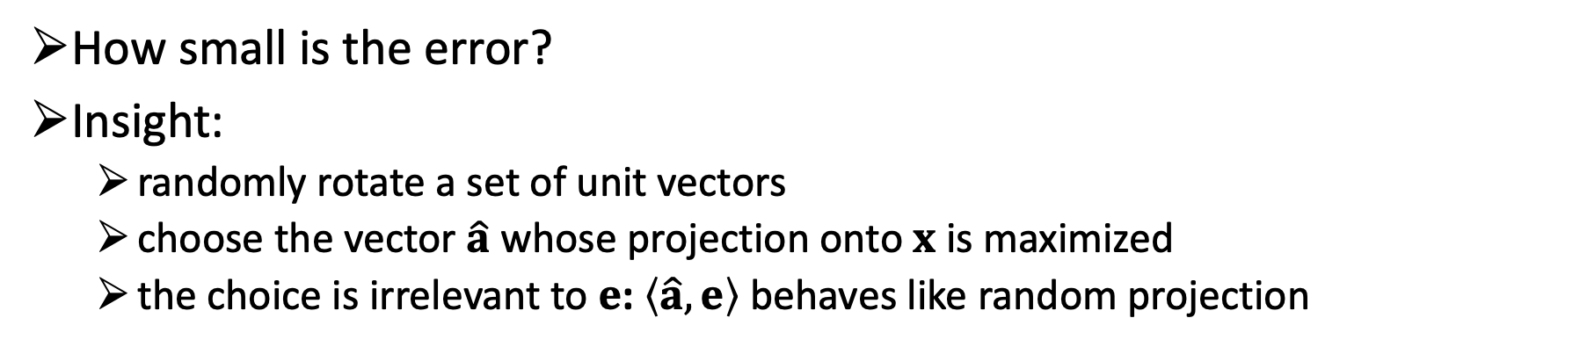
Query Phase
$$a$$ | data vector
$$x$$ | query vector
$$\hat{a}$$ | $$\hat{a}≔arg{\max_{c∈𝒞_{rand}}\left\langle x,c\right\rangle }$$
$$e$$ | $$e≔\frac{x −\left\langle a,x\right\rangle a}{\left\|x −\left\langle a,x\right\rangle a\right\|}$$
$$g$$ | $$g≔\left(g_{1},g_{2},…,g_{D−1}\right),g_{i}∼𝒩\left(0,1\right)$$
How small is the error?
Insight:
  randomly rotate a set of unit vectors
  choose the vector $\hat{a}$ whose projection onto $x$ is maximized
  the choice is irrelevant to $e$: $\left\langle \hat{a},e\right\rangle$ behaves like random projection
decreases exponentially with respect to $B$
Error
bounded by $O\left(\sqrt{\log{N/D}}\right)$

Slide 16
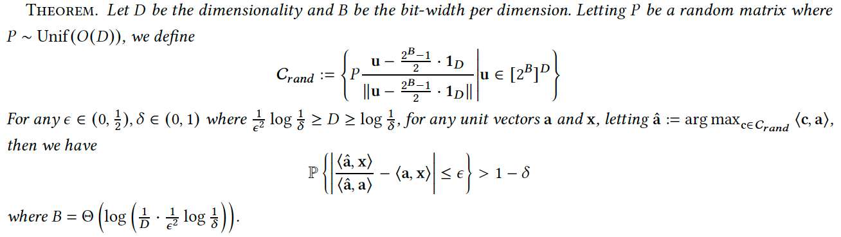
Optimality
The error bound achieves the optimality by [Alon-Klartag ’17]
It can be applied together with JL Lemma when $D≥\frac{1}{ε^{2}}\log{N}$.

Slide 17
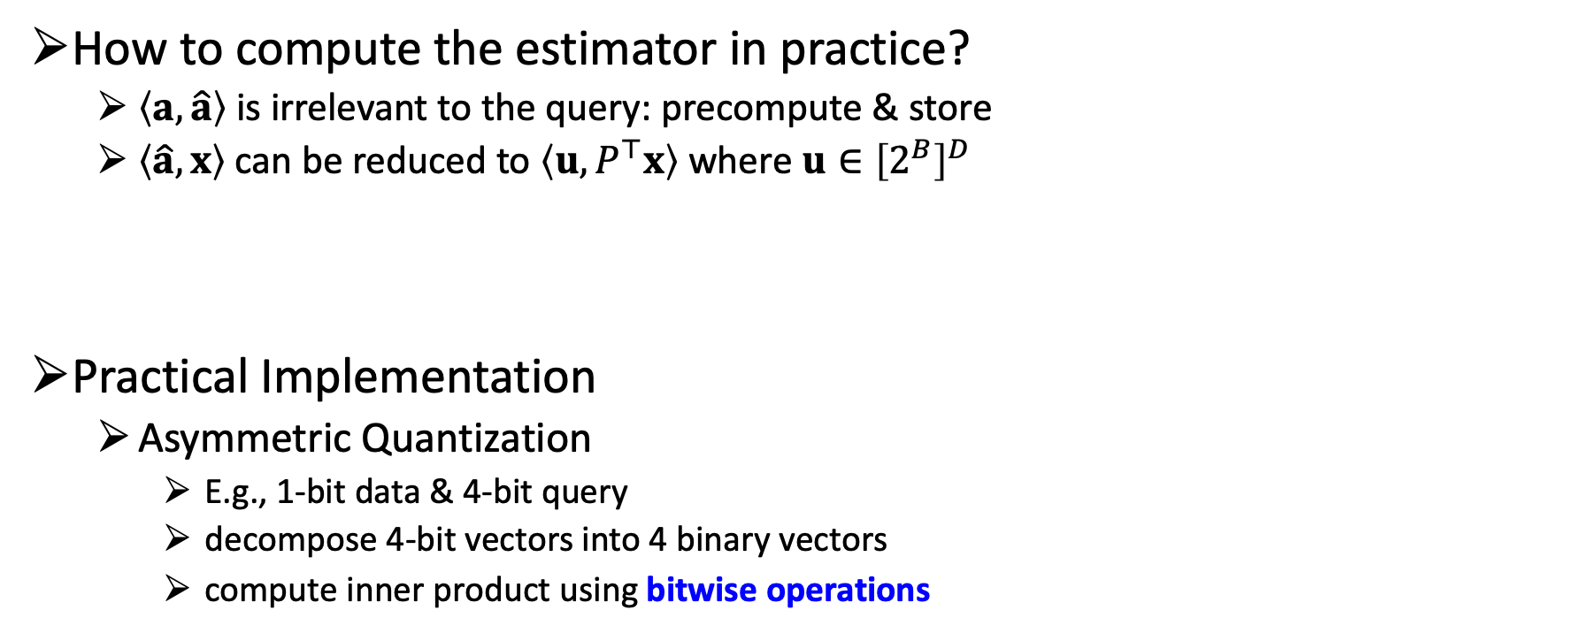
Query Phase
How to compute the estimator in practice?
  $\left\langle a,\hat{a}\right\rangle$ is irrelevant to the query: precompute & store
  $\left\langle \hat{a},x\right\rangle$ can be reduced to $\left\langle u,P^{⊤}x\right\rangle$ where $u∈{\left[2^{B}\right]}^{D}$
Practical Implementation
  Asymmetric Quantization
    E.g., 1-bit data & 4-bit query
    decompose 4-bit vectors into 4 binary vectors
    compute inner product using bitwise operations
Estimator
dim
query
bit
data
*$P^{⊤}x$ can be computed when a query comes and shared by all distance computations.
** The query vector can be quantized via RaBitQ or the naïve uniform scalar quantization.

Slide 18
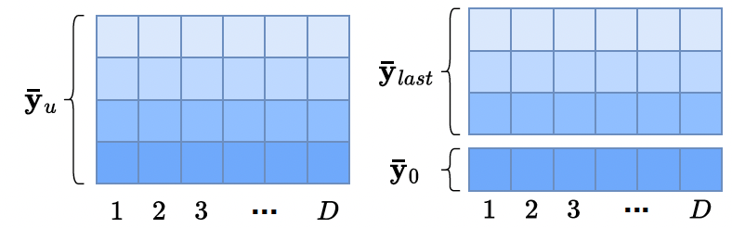
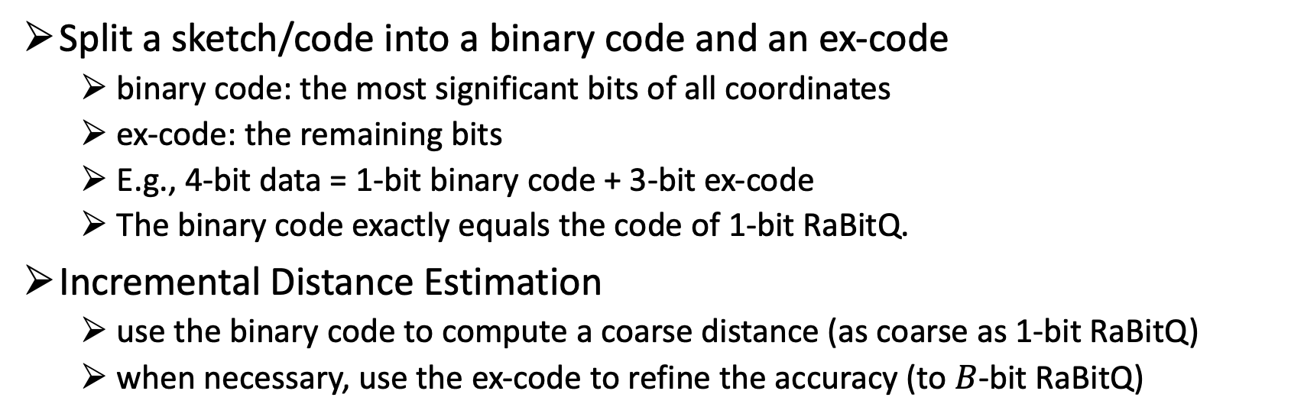
Incremental Distance Estimation
Split a sketch/code into a binary code and an ex-code
  binary code: the most significant bits of all coordinates
  ex-code: the remaining bits
  E.g., 4-bit data = 1-bit binary code + 3-bit ex-code
  The binary code exactly equals the code of 1-bit RaBitQ.
Incremental Distance Estimation
  use the binary code to compute a coarse distance (as coarse as 1-bit RaBitQ)
  when necessary, use the ex-code to refine the accuracy (to $B$-bit RaBitQ)
ex-code
data
binary code

Slide 19
Advantage in System Design
Adaptively Pruning in ANN
  Computing coarse distances with binary codes is fast.
Heterogeneous Storage
  Store binary codes in memory and offload ex-codes onto external memory.
Duplicate
  locality of data, distributed system

Slide 20
Outline
Background
The RaBitQ Algorithm
Empirical Studies
Discussion

Slide 21
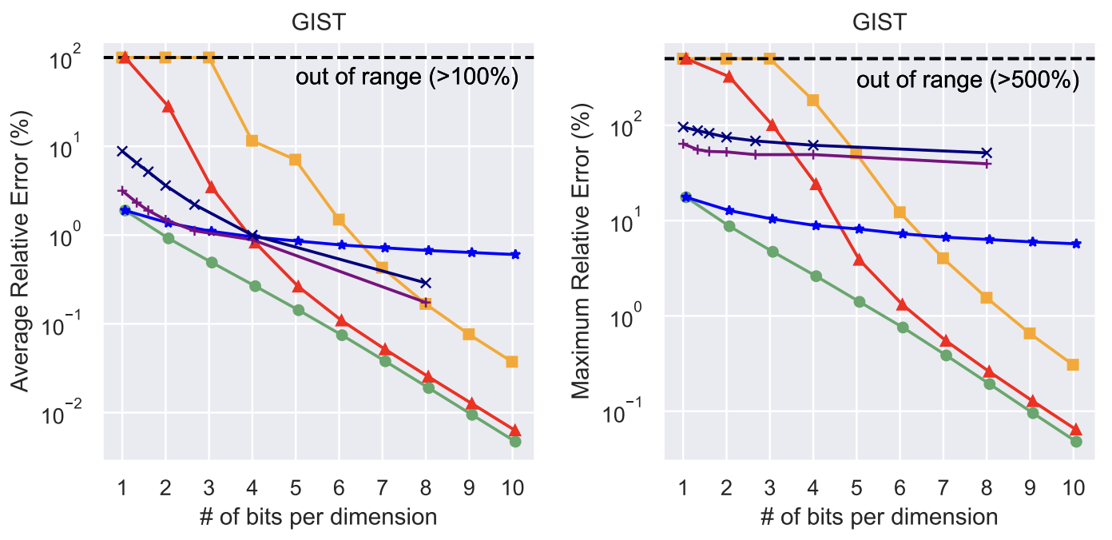
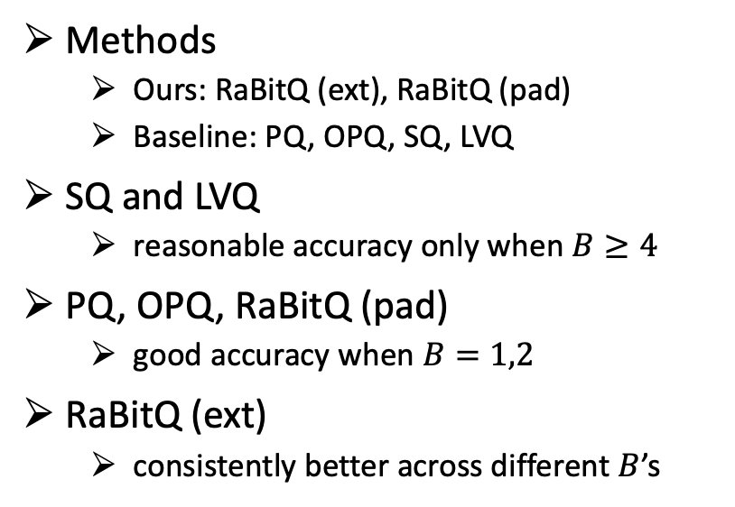
Space-Accuracy Trade-Off for Distance Estimation
Methods
  Ours: RaBitQ (ext), RaBitQ (pad)
  Baseline: PQ, OPQ, SQ, LVQ
SQ and LVQ
  reasonable accuracy only when $B≥4$
PQ, OPQ, RaBitQ (pad)
  good accuracy when $B=1,2$
RaBitQ (ext)
  consistently better across different $B$’s
21

Slide 22
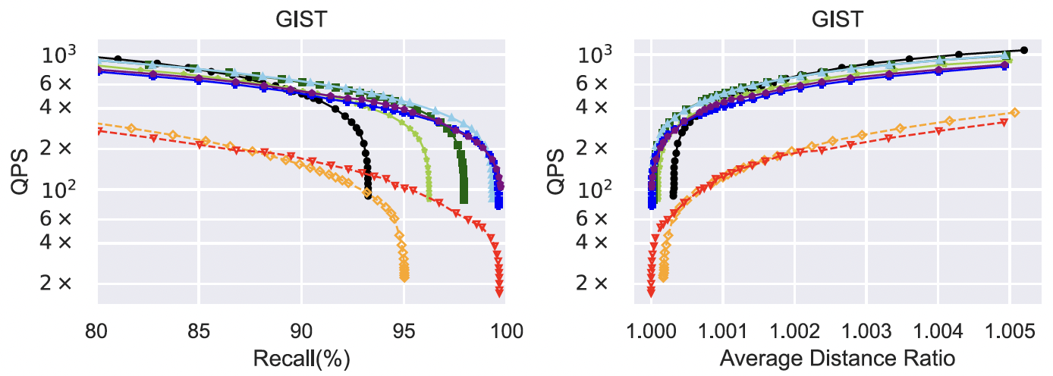
Time-Accuracy Trade-Off for ANN
Methods - RaBitQ vs. LVQ
  PQ and OPQ (256 centroids) are less performant in terms of efficiency.
RaBitQ vs. LVQ
  Better accuracy when using the same bit-width.
  Better efficiency due to incremental distance computation.
22

Slide 23
Outline
Background
The RaBitQ Algorithm
Empirical Studies
Discussion

Slide 24

Discussion
Software: RaBitQ-Library
  Fast Random Rotation
    FFHT from the FALCONN-Lib [Andoni et., al, ‘15].
  Fast Quantization with Heuristics
  RaBitQ for ANN – IVF, HNSW, QG
RaBitQ-Library
Open Problem
  Randomized Hadamard Transformation for RaBitQ.
    Randomized Hadamard Transformation for JL Lemma [Ailon-Chazelle ’09]
  Pairwise Distance Sketch with Multiplicative Error Bounds.
24

Slide 25
















RaBitQ in Industry
VectorChord

Slide 26




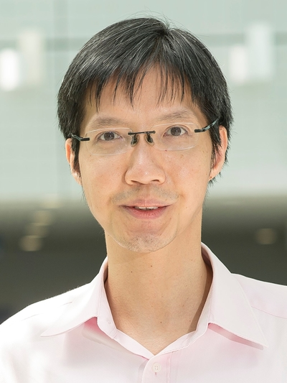
Acknowledgement
Co-authors:
Yutong Gou
NTU
Yuexuan Xu
NTU
Yongyi Yang
UMich
Cheng Long
NTU
Raymond Chi-Wing WONG
HKUST
Acknowledgement
  Jifan Shi (NTU) and Zhonghao Yang (NTU) for their contributions to the RaBitQ Library.
  Yi Li (SPMS, NTU), Yufei Tao (CUHK), and Ravishankar Krishnaswamy (MSR India) for valuable feedbacks to the project.
* Yongyi prefers to keep mysterious.

Slide 27
Q & A
Thanks for your attention!
jianyang.gao@ntu.edu.sg

