Slide 1
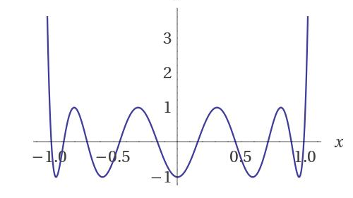
Closest Pair (and Related Problems) using the Polynomial Method
Josh Alman (Columbia)

Slide 2
Polynomial Method
Approximating important functions by low-degree polynomials is prevalent in TCS
Circuit complexity
Learning classes of Boolean functions
Quantum query complexity lower bounds
…
Today: Using these tools to design algorithms for closest pair and related problems
We can often reuse polynomial constructions from other applications!

Slide 3
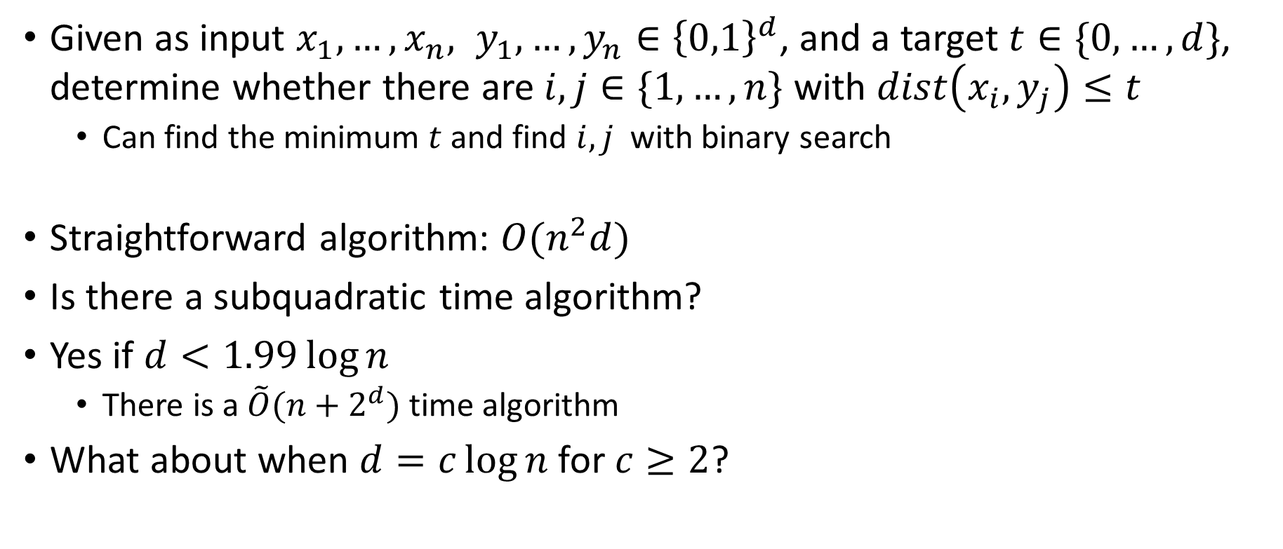
(Exact) Hamming Closest Pair
Given as input $x_{1},…,x_{n}, y_{1},…,y_{n}∈{\left\{0,1\right\}}^{d}$, and a target $t∈\{0,…,d\}$, determine whether there are $i,j∈\{1,…,n\}$ with $dist\left(x_{i},y_{j}\right)≤t$
Can find the minimum $t$ and find $i,j$ with binary search
Straightforward algorithm: $O(n^{2}d)$
Is there a subquadratic time algorithm?
Yes if $d<1.99\log{n}$
There is a $\tilde{O}(n+2^{d})$ time algorithm
What about when $d=c\log{n}$ for $c≥2$?

Slide 4
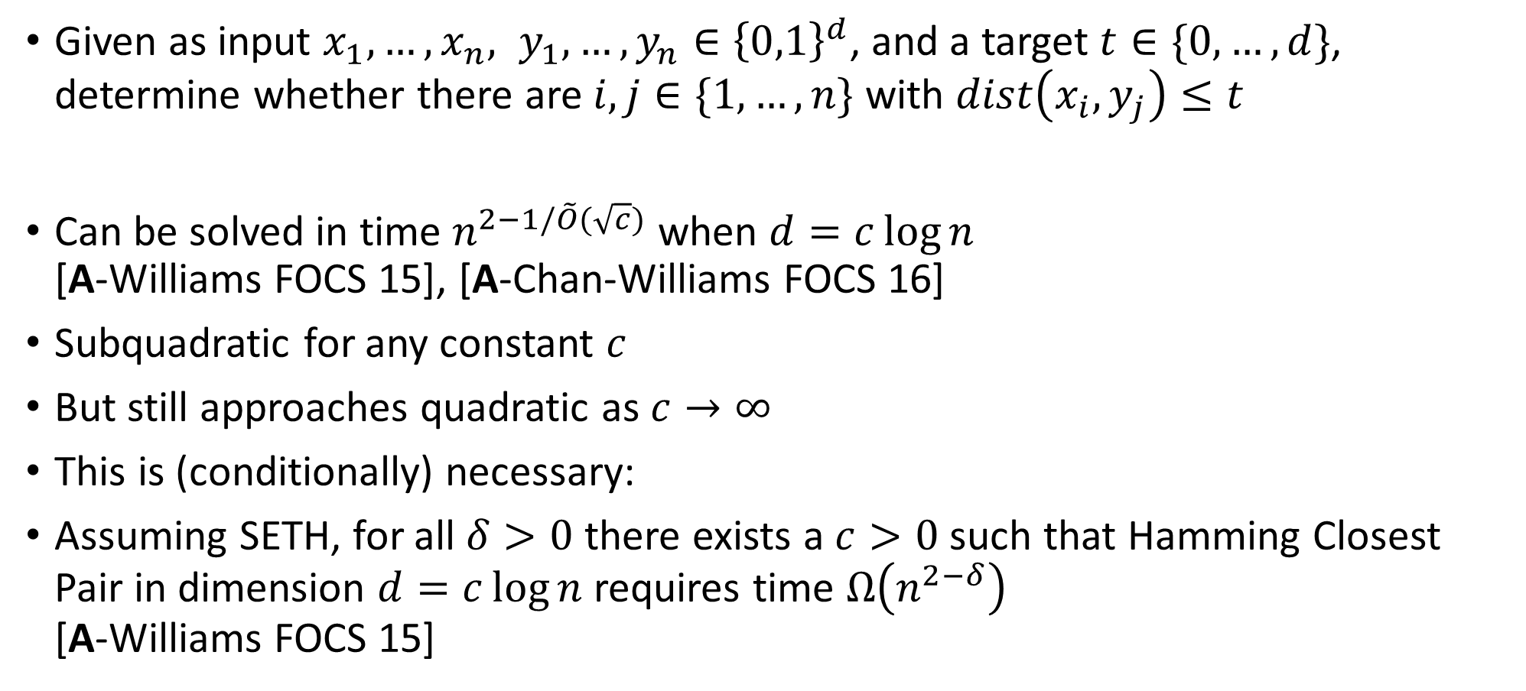
(Exact) Hamming Closest Pair
Given as input $x_{1},…,x_{n}, y_{1},…,y_{n}∈{\left\{0,1\right\}}^{d}$, and a target $t∈\{0,…,d\}$, determine whether there are $i,j∈\{1,…,n\}$ with $dist\left(x_{i},y_{j}\right)≤t$
Can be solved in time $n^{2−1/\tilde{O}(\sqrt{c})}$ when $d=c\log{n}$ [A-Williams FOCS 15], [A-Chan-Williams FOCS 16]
Subquadratic for any constant $c$
But still approaches quadratic as $c→∞$
This is (conditionally) necessary:
Assuming SETH, for all $δ>0$ there exists a $c>0$ such that Hamming Closest Pair in dimension $d=c\log{n}$ requires time $Ω\left(n^{2−δ}\right)$ [A-Williams FOCS 15]

Slide 5

Algorithm Overview
Design a low-degree polynomial $p$ that checks whether two points have distance $≤t$
Quickly evaluate $p$ on all pairs of points using fast matrix multiplication

Slide 6
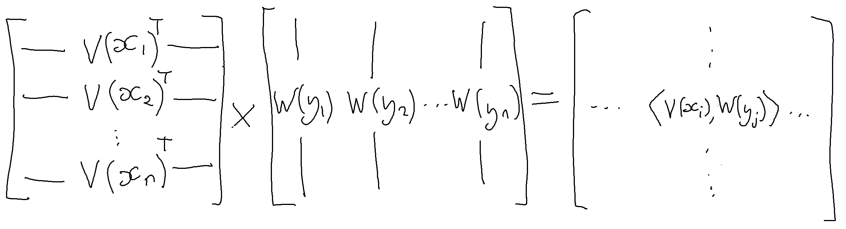
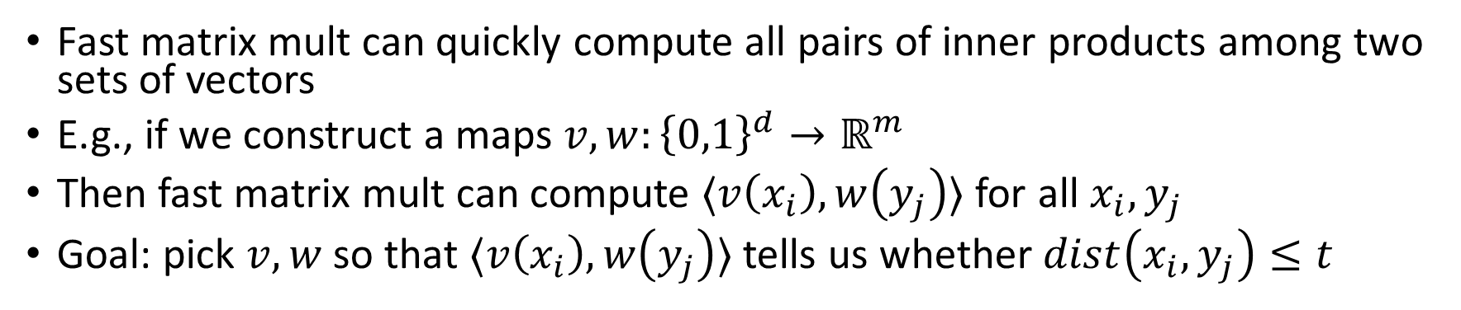
Fast Matrix Multiplication
Fast matrix mult can quickly compute all pairs of inner products among two sets of vectors
E.g., if we construct a maps $v,w:{\left\{0,1\right\}}^{d}→ℝ^{m}$
Then fast matrix mult can compute $〈v\left(x_{i}\right),w\left(y_{j}\right)〉$ for all $x_{i}, y_{j}$
Goal: pick $v,w$ so that $〈v\left(x_{i}\right),w\left(y_{j}\right)〉$ tells us whether $dist\left(x_{i},y_{j}\right)≤t$

Slide 7
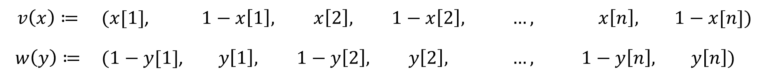
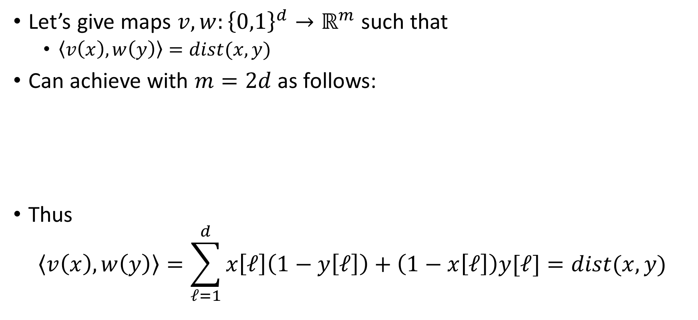
Fast Matrix Multiplication
Let’s give maps $v,w:{\left\{0,1\right\}}^{d}→ℝ^{m}$ such that
$〈v\left(x\right), w\left(y\right)〉=dist(x,y)$
Can achieve with $m=2d$ as follows:
Thus
$$〈v\left(x\right),w\left(y\right)〉=\sum_{ℓ=1}^{d}{x\left[ℓ\right]\left(1−y\left[ℓ\right]\right)+\left(1−x\left[ℓ\right]\right)y[ℓ]}=dist(x,y)$$
$$v\left(x\right)≔$$ | $(x[1]$, | $$1−x\left[1\right],$$ | $$x\left[2\right],$$ | $$1−x\left[2\right],$$ | $$…,$$ | $$x\left[n\right],$$ | $$1−x[n])$$
$$w\left(y\right)≔$$ | $(1−y[1]$, | $$y\left[1\right],$$ | $$1−y\left[2\right],$$ | $$y\left[2\right],$$ | $$…,$$ | $$1−y\left[n\right],$$ | $$y\left[n\right])$$

Slide 8
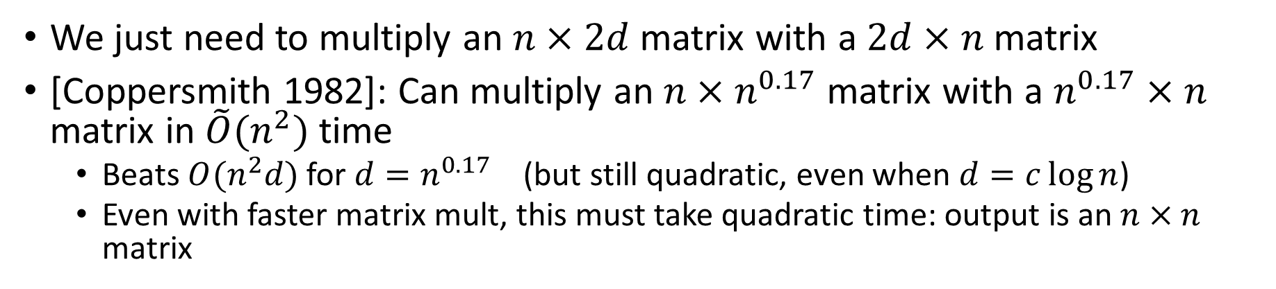
Fast Matrix Multiplication
We just need to multiply an $n×2d$ matrix with a $2d×n$ matrix
[Coppersmith 1982]: Can multiply an $n×n^{0.17}$ matrix with a $n^{0.17}×n$ matrix in $\tilde{O}(n^{2})$ time
Beats $O(n^{2}d)$ for $d=n^{0.17}$ (but still quadratic, even when $d=c\log{n}$)
Even with faster matrix mult, this must take quadratic time: output is an $n×n$ matrix

Slide 9
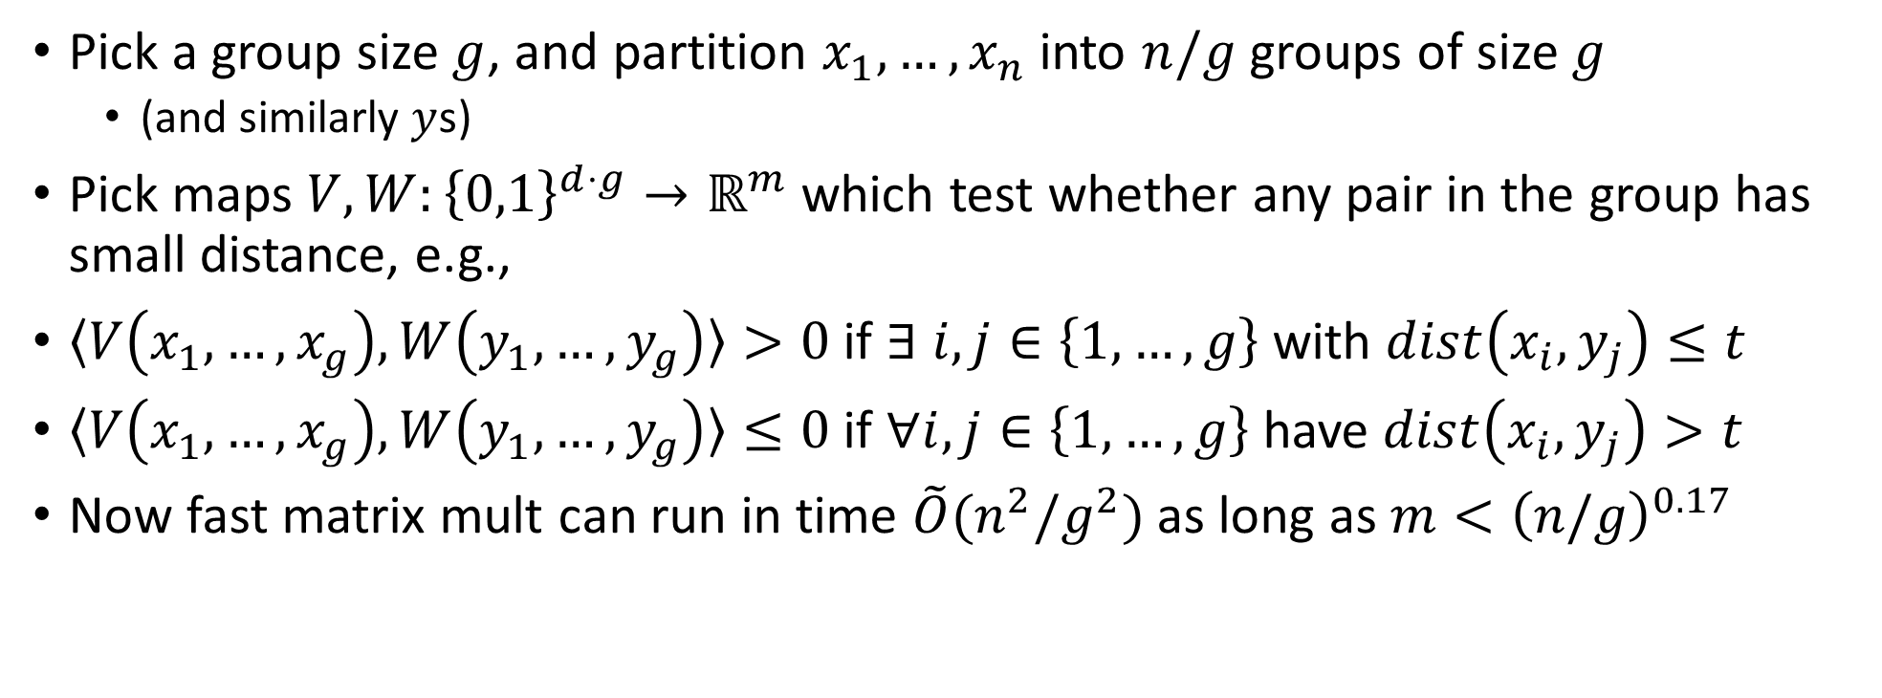
Key Idea: Grouping
Pick a group size $g$, and partition $x_{1},…,x_{n}$ into $n/g$ groups of size $g$
(and similarly $y$s)
Pick maps $V,W:{\left\{0,1\right\}}^{d⋅g}→ℝ^{m}$ which test whether any pair in the group has small distance, e.g.,
$〈V\left(x_{1},…,x_{g}\right),W\left(y_{1},…,y_{g}\right)〉>0$ if $∃ i,j∈\left\{1,…,g\right\}$ with $dist\left(x_{i},y_{j}\right)≤t$
$〈V\left(x_{1},…,x_{g}\right),W\left(y_{1},…,y_{g}\right)〉≤0$ if $∀i,j∈\left\{1,…,g\right\}$ have $dist\left(x_{i},y_{j}\right)>t$
Now fast matrix mult can run in time $\tilde{O}(n^{2}/g^{2})$ as long as $m<{\left(n/g\right)}^{0.17}$

Slide 10
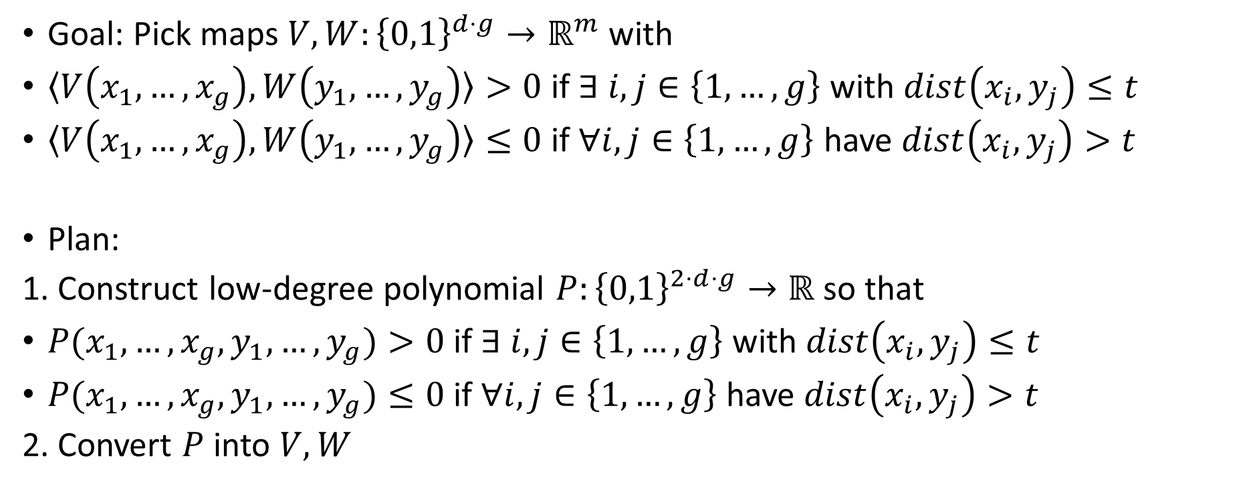
Polynomial Method
Goal: Pick maps $V,W:{\left\{0,1\right\}}^{d⋅g}→ℝ^{m}$ with
$〈V\left(x_{1},…,x_{g}\right),W\left(y_{1},…,y_{g}\right)〉>0$ if $∃ i,j∈\left\{1,…,g\right\}$ with $dist\left(x_{i},y_{j}\right)≤t$
$〈V\left(x_{1},…,x_{g}\right),W\left(y_{1},…,y_{g}\right)〉≤0$ if $∀i,j∈\left\{1,…,g\right\}$ have $dist\left(x_{i},y_{j}\right)>t$
Plan:
1. Construct low-degree polynomial $P:{\left\{0,1\right\}}^{2⋅d⋅g}→ℝ$ so that
$P(x_{1},…,x_{g},y_{1},…,y_{g})>0$ if $∃ i,j∈\left\{1,…,g\right\}$ with $dist\left(x_{i},y_{j}\right)≤t$
$P(x_{1},…,x_{g},y_{1},…,y_{g})≤0$ if $∀i,j∈\left\{1,…,g\right\}$ have $dist\left(x_{i},y_{j}\right)>t$
2. Convert $P$ into $V,W$

Slide 11
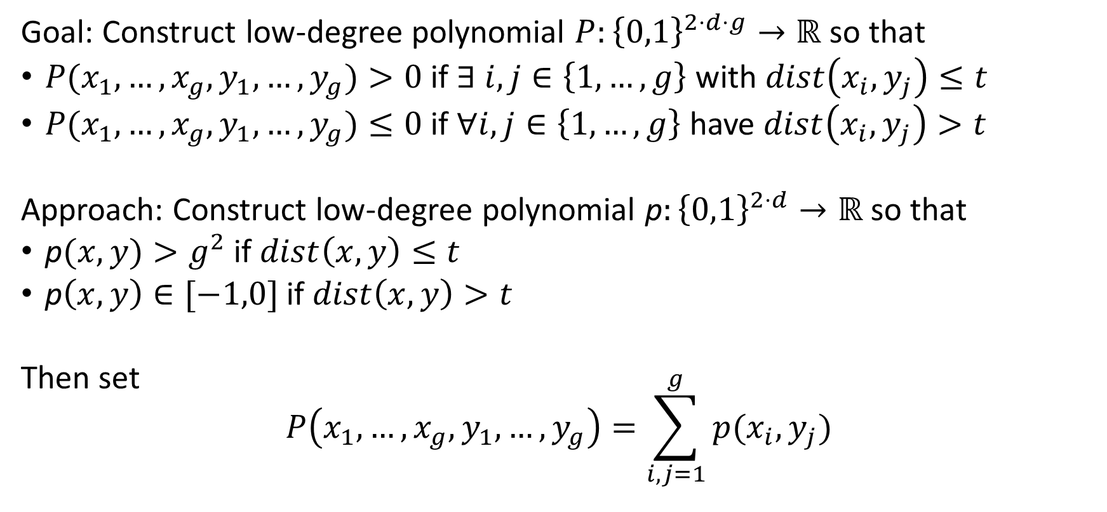
Construct Polynomial
Goal: Construct low-degree polynomial $P:{\left\{0,1\right\}}^{2⋅d⋅g}→ℝ$ so that
$P(x_{1},…,x_{g},y_{1},…,y_{g})>0$ if $∃ i,j∈\left\{1,…,g\right\}$ with $dist\left(x_{i},y_{j}\right)≤t$
$P(x_{1},…,x_{g},y_{1},…,y_{g})≤0$ if $∀i,j∈\left\{1,…,g\right\}$ have $dist\left(x_{i},y_{j}\right)>t$
Approach: Construct low-degree polynomial p$:{\left\{0,1\right\}}^{2⋅d}→ℝ$ so that
p$(x,y)>g^{2}$ if $dist\left(x,y\right)≤t$
p$\left(x,y\right)∈[−1,0]$ if $dist\left(x,y\right)>t$
Then set $$P\left(x_{1},…,x_{g},y_{1},…,y_{g}\right)=\sum_{i,j=1}^{g}{p(x_{i},y_{j})}$$

Slide 12
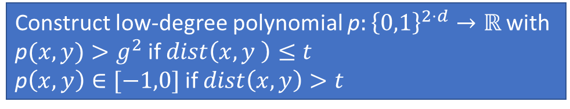
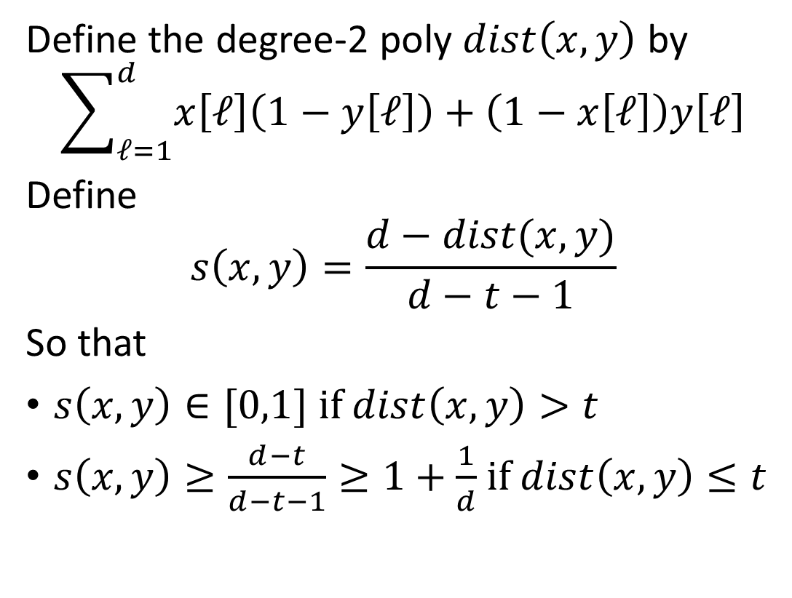

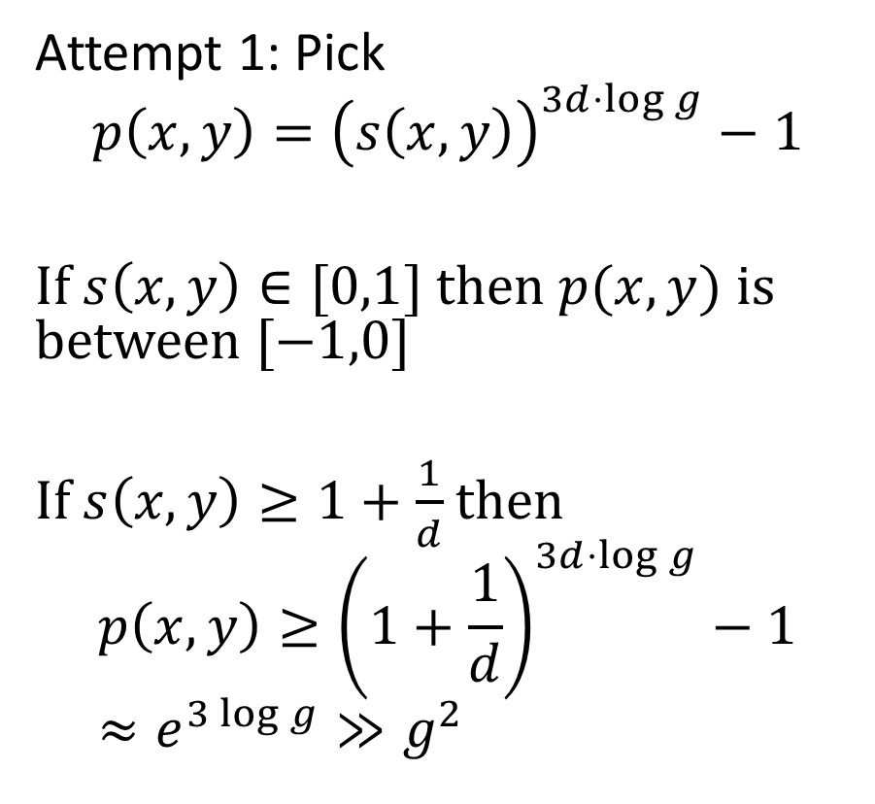
Construct Polynomial
Construct low-degree polynomial p$:{\left\{0,1\right\}}^{2⋅d}→ℝ$ with p$(x,y)>g^{2}$ if $dist\left(x,y \right)≤t$
p$\left(x,y\right)∈[−1,0]$ if $dist\left(x,y\right)>t$
Define the degree-2 poly $dist\left(x,y\right)$ by
$$\sum_{ℓ=1}^{d}{x\left[ℓ\right]\left(1−y\left[ℓ\right]\right)+\left(1−x\left[ℓ\right]\right)y\left[ℓ\right]}$$
Define
$$s\left(x,y\right)=\frac{d−dist(x,y)}{d−t−1}$$
So that
$s\left(x,y\right)∈[0,1]$ if $dist\left(x,y\right)>t$
$s\left(x,y\right)≥\frac{d−t}{d−t−1}≥1+\frac{1}{d}$ if $dist\left(x,y\right)≤t$
Attempt 1: Pick
$$p\left(x,y\right)={\left(s\left(x,y\right)\right)}^{3d⋅\log{g}}−1$$
If $s\left(x,y\right)∈[0,1]$ then $p(x,y)$ is between $[−1,0]$
If $s\left(x,y\right)≥1+\frac{1}{d}$ then
$$p\left(x,y\right)≥{\left(1+\frac{1}{d}\right)}^{3d⋅\log{g}}−1 \\ ≈e^{3\log{g}}≫g^{2}$$
Degree $6d\log{g}$, which is too high!

Slide 13
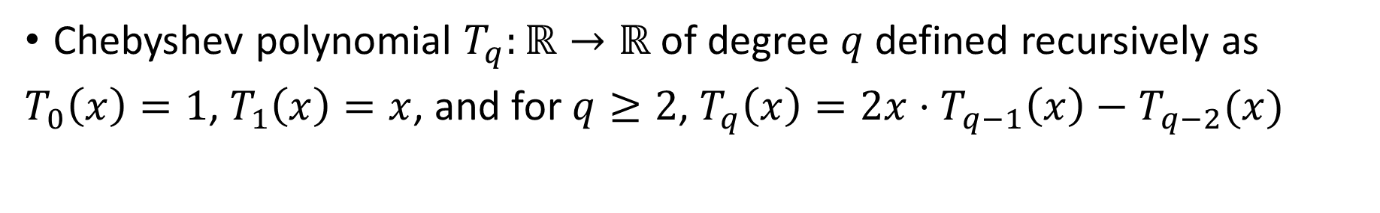

Key tool: Chebyshev polynomials
Chebyshev polynomial $T_{q}:ℝ→ℝ$ of degree $q$ defined recursively as
$T_{0}\left(x\right)=1$, $T_{1}\left(x\right)=x$, and for $q≥2$, $T_{q}\left(x\right)=2x⋅T_{q−1}\left(x\right)−T_{q−2}(x)$
$$T_{10}\left(x\right)=−1 + 50 x^{2} − 400 x^{4} \\ + 1120 x^{6} − 1280 x^{8} + 512 x^{10}$$

Slide 14
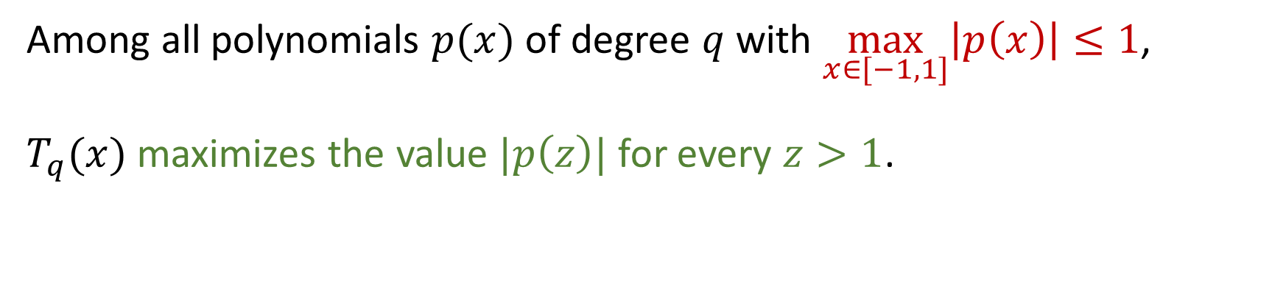

Key tool: Chebyshev polynomials
Among all polynomials $p(x)$ of degree $q$ with $\max_{x∈[−1,1]}\left|p\left(x\right)\right|≤1$, $T_{q}(x)$ maximizes the value $|p\left(z\right)|$ for every $z>1$.
$$T_{q}\left(1+ε\right)>\frac{1}{2}e^{q\sqrt{ε}}$$
$$T_{10}\left(x\right)=−1 + 50 x^{2} − 400 x^{4} \\ + 1120 x^{6} − 1280 x^{8} + 512 x^{10}$$

Slide 15
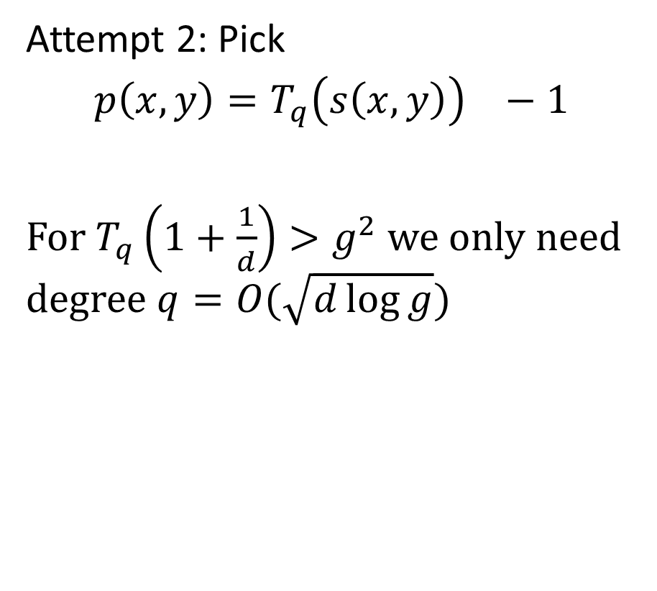
Construct Polynomial
Construct low-degree polynomial p$:{\left\{0,1\right\}}^{2⋅d}→ℝ$ with p$(x,y)>g^{2}$ if $dist\left(x,y \right)≤t$
p$\left(x,y\right)∈[−1,0]$ if $dist\left(x,y\right)>t$
Define the degree-2 poly $dist\left(x,y\right)$ by
$$\sum_{ℓ=1}^{d}{x\left[ℓ\right]\left(1−y\left[ℓ\right]\right)+\left(1−x\left[ℓ\right]\right)y\left[ℓ\right]}$$
Define
$$s\left(x,y\right)=\frac{d−dist(x,y)}{d−t−1}$$
So that
$s\left(x,y\right)∈[0,1]$ if $dist\left(x,y\right)>t$
$s\left(x,y\right)≥\frac{d−t}{d−t−1}≥1+\frac{1}{d}$ if $dist\left(x,y\right)≤t$
Attempt 2: Pick
$$p\left(x,y\right)={T_{q}\left(s\left(x,y\right)\right)}^{}−1$$
For $T_{q}\left(1+\frac{1}{d}\right)>g^{2}$ we only need degree $q=O(\sqrt{d\log{g}})$

Slide 16
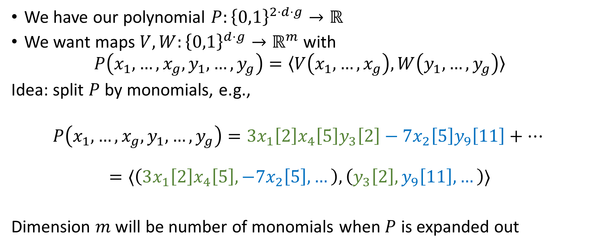
Convert Polynomial Into Vectors
We have our polynomial $P:{\left\{0,1\right\}}^{2⋅d⋅g}→ℝ$
We want maps $V,W:{\left\{0,1\right\}}^{d⋅g}→ℝ^{m}$ with
$$P\left(x_{1},…,x_{g},y_{1},…,y_{g}\right)=〈V\left(x_{1},…,x_{g}\right),W\left(y_{1},…,y_{g}\right)〉$$
Idea: split $P$ by monomials, e.g.,
$$P\left(x_{1},…,x_{g},y_{1},…,y_{g}\right)=3x_{1}\left[2\right]x_{4}\left[5\right]y_{3}\left[2\right]−7x_{2}\left[5\right]y_{9}\left[11\right]+…$$
$$=〈\left(3x_{1}\left[2\right]x_{4}\left[5\right],−7x_{2}\left[5\right],…\right),\left(y_{3}\left[2\right],y_{9}\left[11\right],…\right)〉$$
Dimension $m$ will be number of monomials when $P$ is expanded out

Slide 17
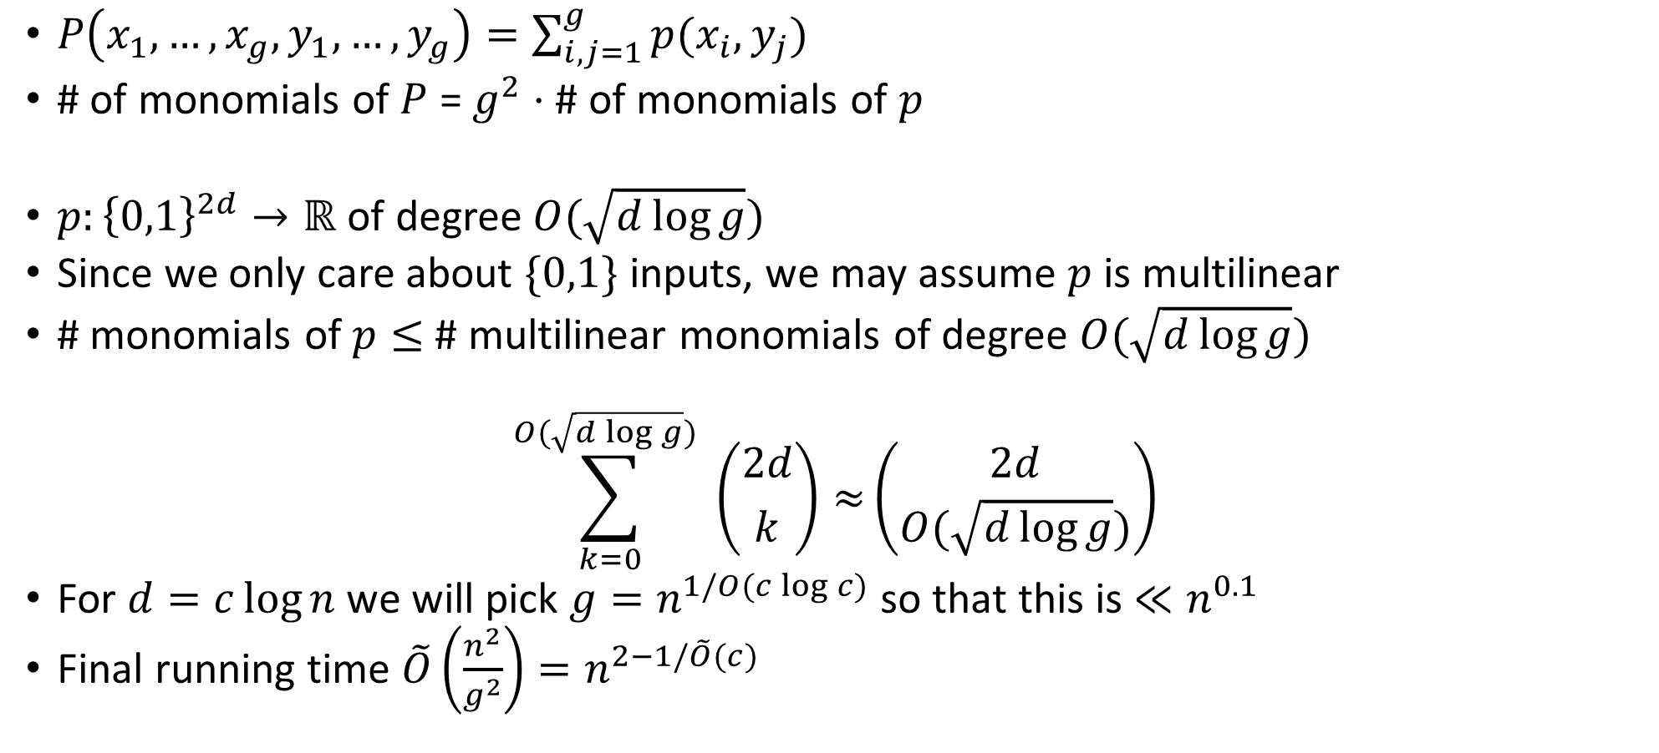
Putting it all together (counting monomials)
$P\left(x_{1},…,x_{g},y_{1},…,y_{g}\right)=\sum_{i,j=1}^{g}{p(x_{i},y_{j})}$
# of monomials of $P$ = $g^{2}⋅$ # of monomials of $p$
$p:{\left\{0,1\right\}}^{2d}→ℝ$ of degree $O(\sqrt{d\log{g}})$
Since we only care about $\{0,1\}$ inputs, we may assume $p$ is multilinear
# monomials of $p≤$ # multilinear monomials of degree $O(\sqrt{d\log{g}})$
$$\sum_{k=0}^{O(\sqrt{d\log{g}}) }{\left({2d \atop k}\right)≈}\left({2d \atop O(\sqrt{d\log{g}})}\right)$$
For $d=c\log{n}$ we will pick $g=n^{1/O(c\log{c})}$ so that this is $≪n^{0.1}$
Final running time $\tilde{O}\left(\frac{n^{2}}{g^{2}}\right)=n^{2−1/\tilde{O}(c)}$

Slide 18
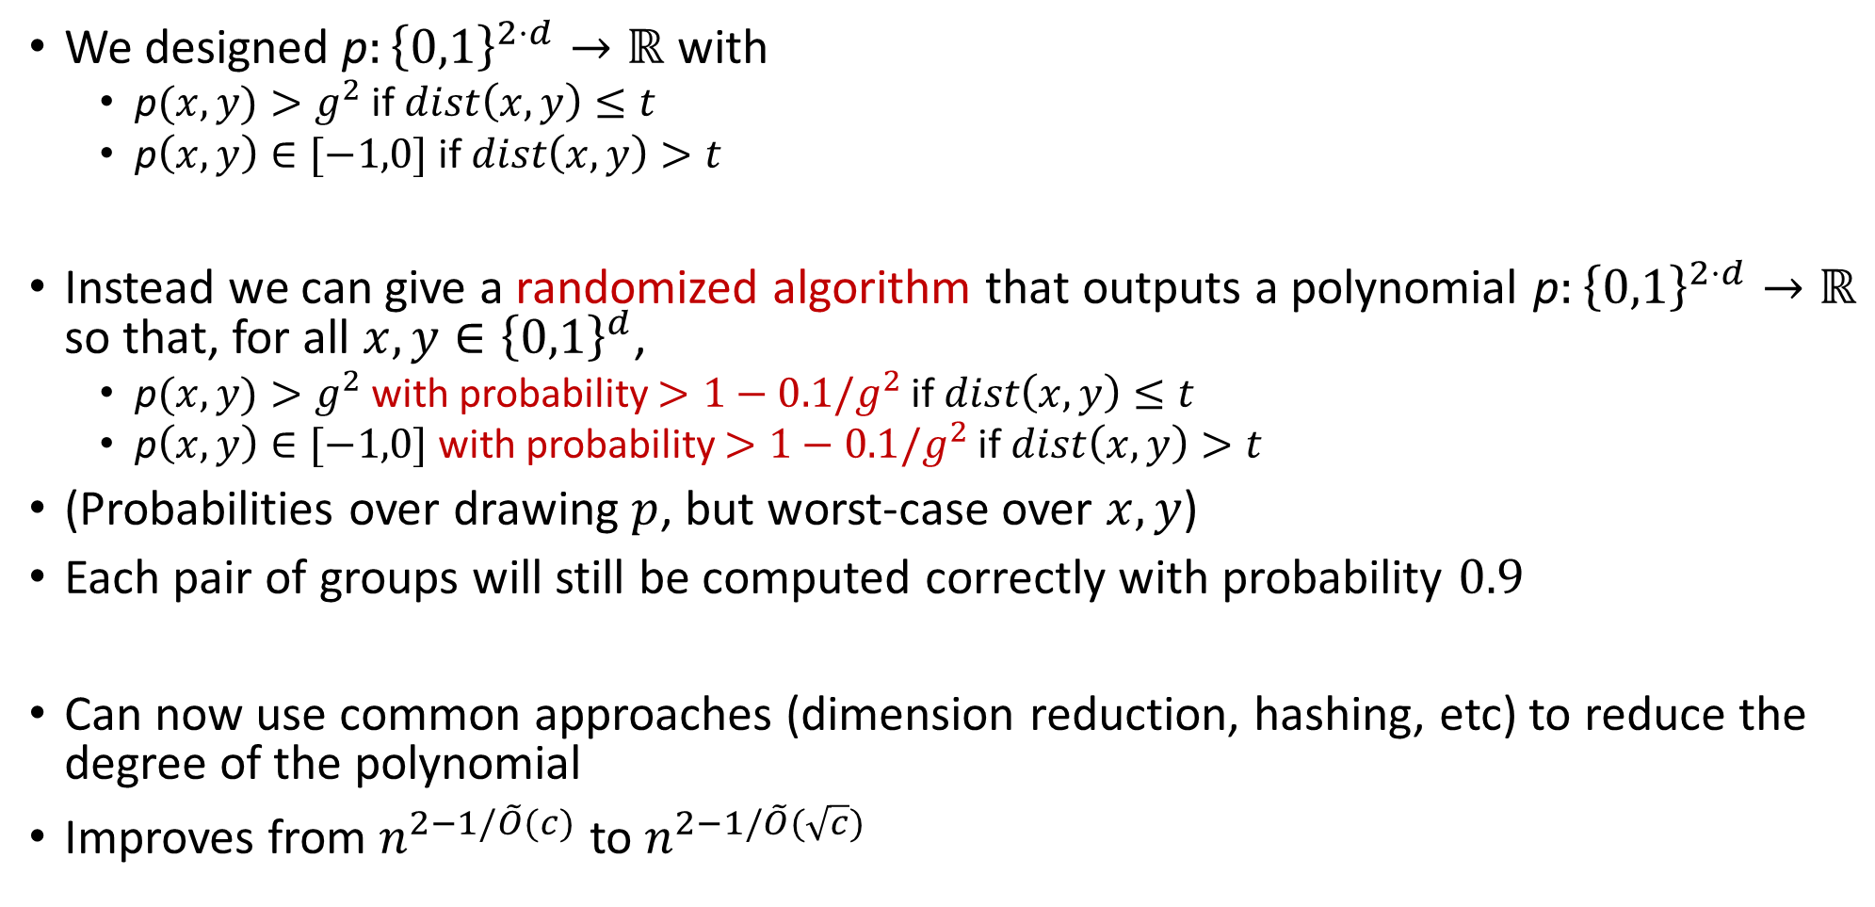
Improvement: Probabilistic Polynomial
We designed p$:{\left\{0,1\right\}}^{2⋅d}→ℝ$ with
p$(x,y)>g^{2}$ if $dist\left(x,y\right)≤t$
p$\left(x,y\right)∈[−1,0]$ if $dist\left(x,y\right)>t$
Instead we can give a randomized algorithm that outputs a polynomial p$:{\left\{0,1\right\}}^{2⋅d}→ℝ$ so that, for all $x,y∈{\left\{0,1\right\}}^{d}$,
p$(x,y)>g^{2}$ with probability $>1−0.1/g^{2}$ if $dist\left(x,y\right)≤t$
p$\left(x,y\right)∈[−1,0]$ with probability $>1−0.1/g^{2}$ if $dist\left(x,y\right)>t$
(Probabilities over drawing $p$, but worst-case over $x,y$)
Each pair of groups will still be computed correctly with probability $0.9$
Can now use common approaches (dimension reduction, hashing, etc) to reduce the degree of the polynomial
Improves from $n^{2−1/\tilde{O}(c)}$ to $n^{2−1/\tilde{O}(\sqrt{c})}$

Slide 19
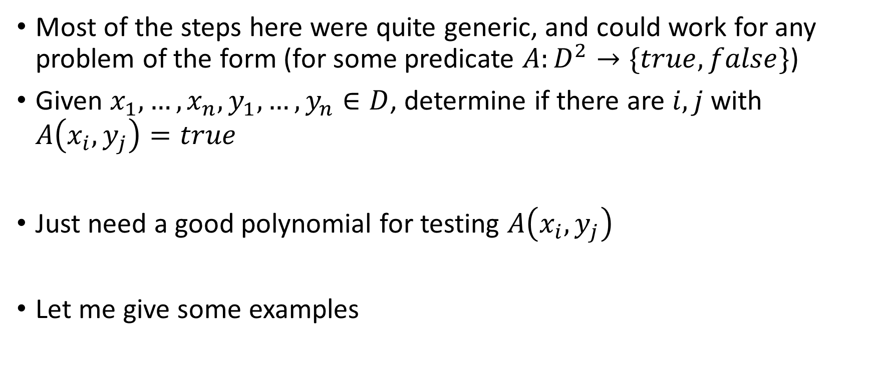
Other Applications
Most of the steps here were quite generic, and could work for any problem of the form (for some predicate $A:D^{2}→\{true,false\}$)
Given $x_{1},…,x_{n},y_{1},…,y_{n}∈D$, determine if there are $i,j$ with $A\left(x_{i},y_{j}\right)=true$
Just need a good polynomial for testing $A\left(x_{i},y_{j}\right)$
Let me give some examples

Slide 20
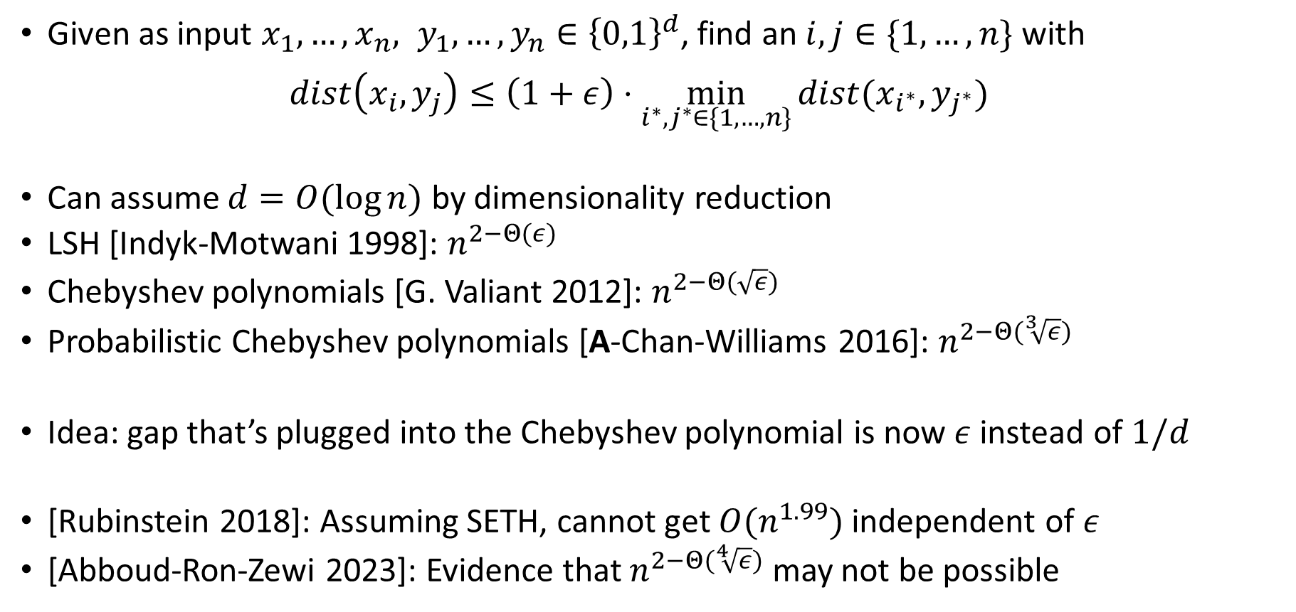
Approximate Hamming Closest Pair
Given as input $x_{1},…,x_{n}, y_{1},…,y_{n}∈{\left\{0,1\right\}}^{d}$, find an $i,j∈\{1,…,n\}$ with $dist\left(x_{i},y_{j}\right)≤\left(1+ε\right)⋅\min_{i^{∗},j^{∗}∈\{1,…,n\}}{dist(x_{i^{∗}},y_{j^{∗}})}$
Can assume $d=O(\log{n})$ by dimensionality reduction
LSH [Indyk-Motwani 1998]: $n^{2−Θ(ε)}$
Chebyshev polynomials [G. Valiant 2012]: $n^{2−Θ(\sqrt{ε})}$
Probabilistic Chebyshev polynomials [A-Chan-Williams 2016]: $n^{2−Θ(\sqrt[3]{ε})}$
Idea: gap that’s plugged into the Chebyshev polynomial is now $ε$ instead of $1/d$
[Rubinstein 2018]: Assuming SETH, cannot get $O(n^{1.99})$ independent of $ε$
[Abboud-Ron-Zewi 2023]: Evidence that $n^{2−Θ(\sqrt[4]{ε})}$ may not be possible

Slide 21
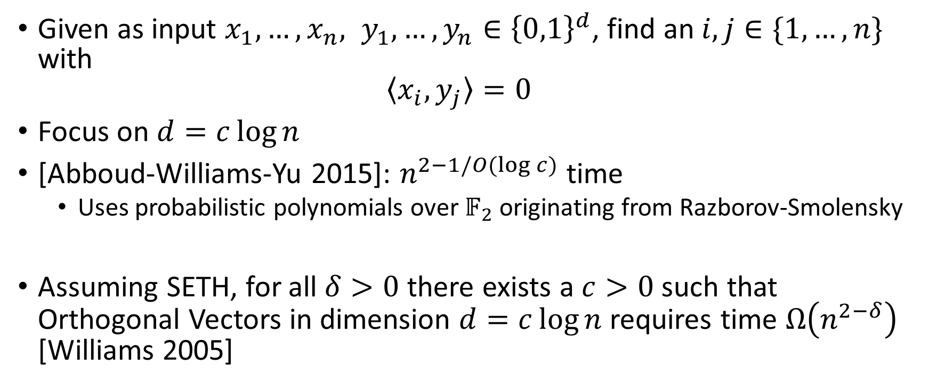
Orthogonal Vectors
Given as input $x_{1},…,x_{n}, y_{1},…,y_{n}∈{\left\{0,1\right\}}^{d}$, find an $i,j∈\{1,…,n\}$ with $〈x_{i}, y_{j}〉=0$
Focus on $d=c\log{n}$
[Abboud-Williams-Yu 2015]: $n^{2−1/O(\log{c})}$ time
Uses probabilistic polynomials over $𝔽_{2}$ originating from Razborov-Smolensky
Assuming SETH, for all $δ>0$ there exists a $c>0$ such that Orthogonal Vectors in dimension $d=c\log{n}$ requires time $Ω\left(n^{2−δ}\right)$ [Williams 2005]

Slide 22
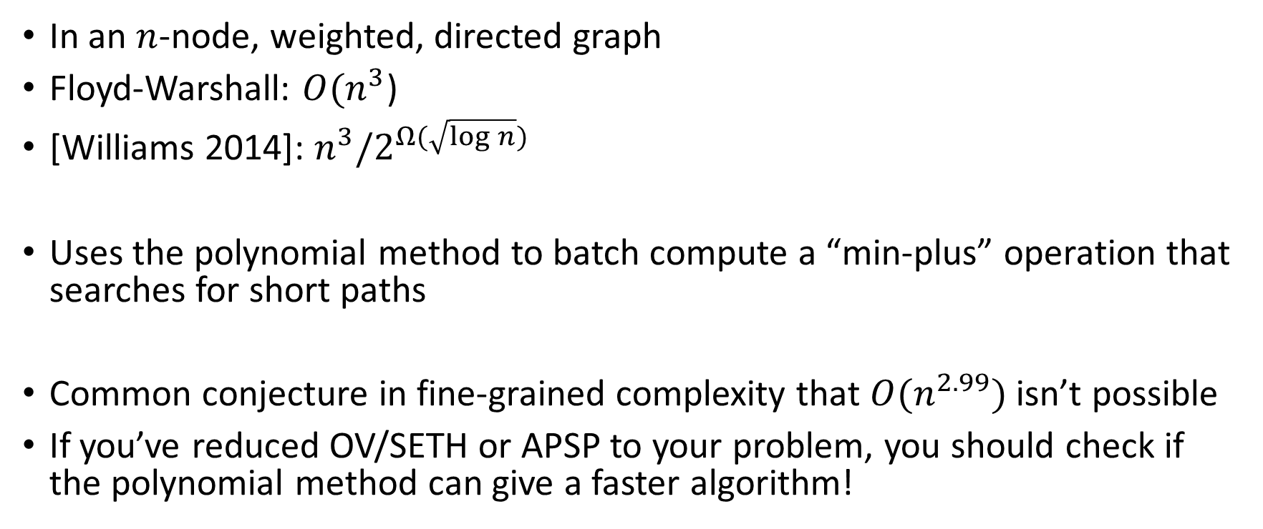
All-Pairs Shortest Paths
In an $n$-node, weighted, directed graph
Floyd-Warshall: $O(n^{3}$)
[Williams 2014]: $n^{3}/2^{Ω(\sqrt{\log{n}})}$
Uses the polynomial method to batch compute a “min-plus” operation that searches for short paths
Common conjecture in fine-grained complexity that $O(n^{2.99})$ isn’t possible
If you’ve reduced OV/SETH or APSP to your problem, you should check if the polynomial method can give a faster algorithm!

Slide 23
Practical?
Worst Offenders:
Matrix Mult
Asymptotics of Polynomials

